Slide 1
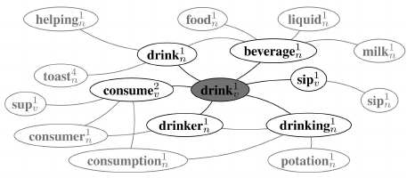
WordNet
Synsets(word)
Wup_similarity(word1_ss, word2_ss)

